Slide 1
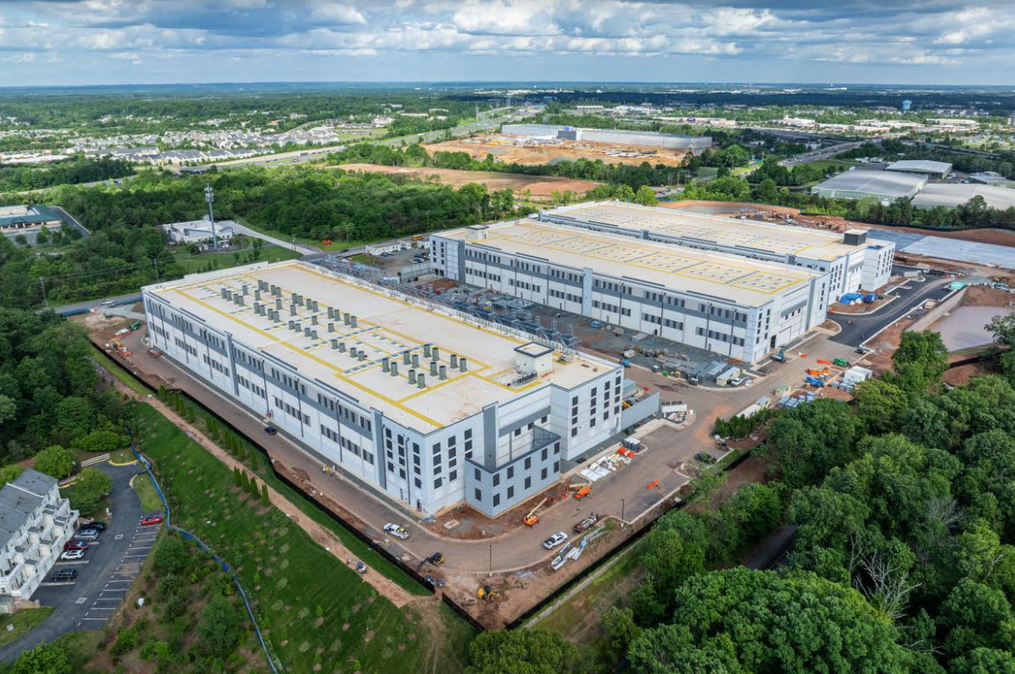

Data Centers Overview
Maryland and Montgomery County

Slide 2
Overview
General Concerns
State and Regional Picture
The Dickerson Site
Pending MoCo Legislation

Slide 3
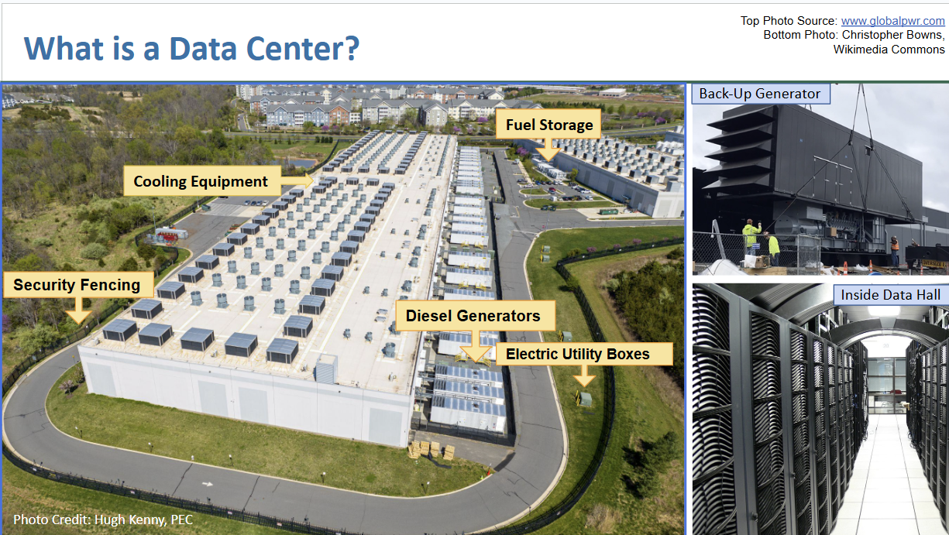
Notes:
Mariah
24/7 power needs filled by backup diesel generators, racks of servers inside serviced by very few employees, cooling needs fulfilled by energy expensive air cooling or potable water evaporation

Slide 4
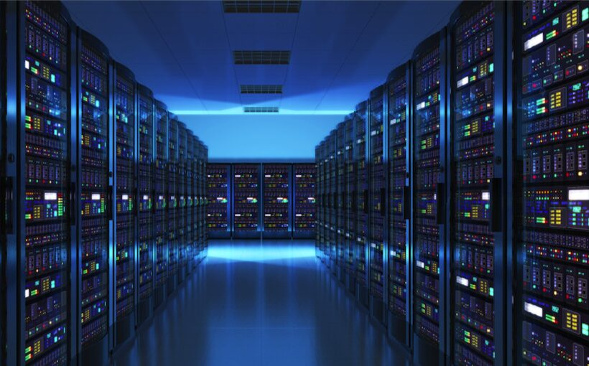
Why Are There So Many?
“The Cloud” - all of our digital lives
Every App, Website, Transaction, Record, Photo
Large Language AI models sending this into overdrive
Notes:
Mariah
We all use data centers - all of our modern digital stuff is there - the key is balancing this use. Large Language AI models like Chat GPT need an extreme amount of data center capacity to train. This is the key driver of the push for data centers

Slide 5
The Problems With Data Centers:
Competition for Land/Farms
Massive Potable Water Use
Heavy Power Needs
Undermining Climate Goals
Financially Burdensome - Inequitable - Opaque
Notes:
Mariah
We will now briefly take each issue with data centers that causes concerns in the state and here in the County. The big picture is how resource hungry these facilities are - each with the power and water needs of a small city -being plopped down without the planning for that resource use

Slide 6
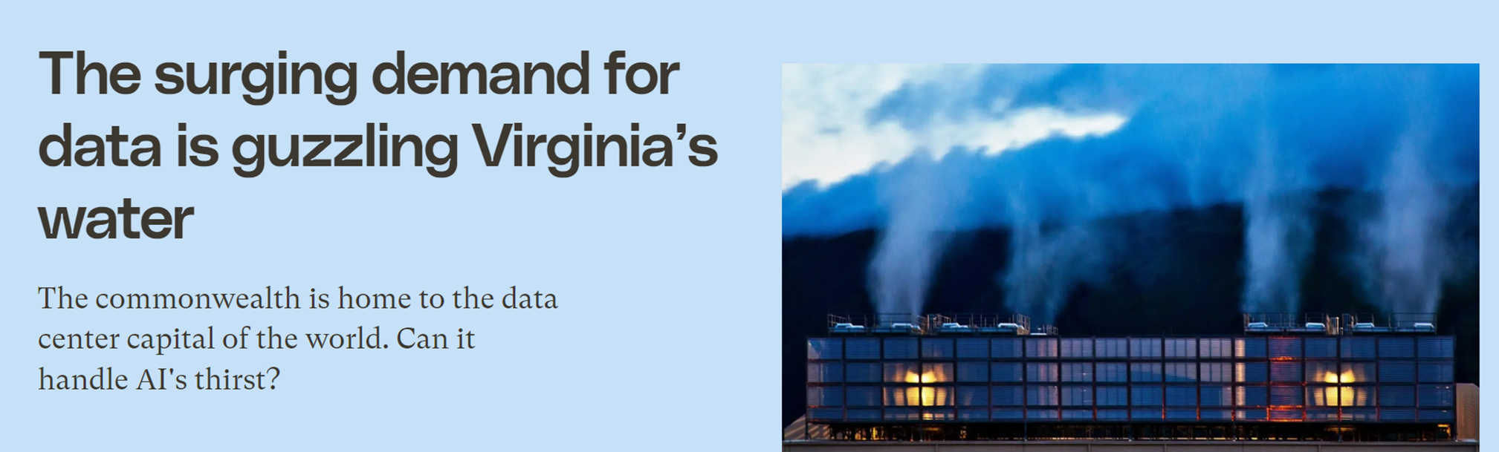
Massive Water Use
Data centers are in the top 10 water consuming industries
A large data center can use 5 million gallons per day
For the most part the water must be potable and evaporative cooling is used - meaning much of the water is lost to the atmosphere
GRIST
Notes:
Mariah

Slide 7
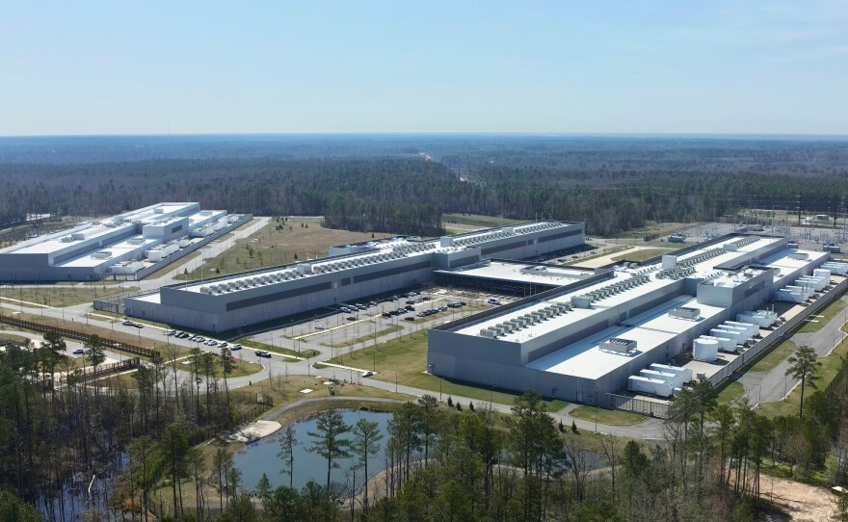
AI is driving data centers
A Cornell Study on state by state impact of AI has shown by 2030 the current rate of AI growth would:
Annually put 24 to 44 million metric tons of carbon dioxide into the atmosphere, the emissions equivalent of adding 5 to 10 million cars to U.S. roadways.
Drain 731 to 1,125 million cubic meters of water per year – equal to the annual household water usage of 6 to 10 million Americans.
Notes:
Mariah

Slide 8
Where are we today? (State/ Regional Level)
Besides the removal of the cap on emissions, there are no state level policies specifically governing data centers.
Frederick County convened a working group to advise on policy and the group has provided recommendations.
Prince George's has recently enacted a moratorium pending more study and crafted a report with 14 suggested regulatory policies.
In Montgomery County - there is currently no zoning provision for this type of land use, nor a government convened working group studying the issue.
Notes:
Caroline

Slide 9
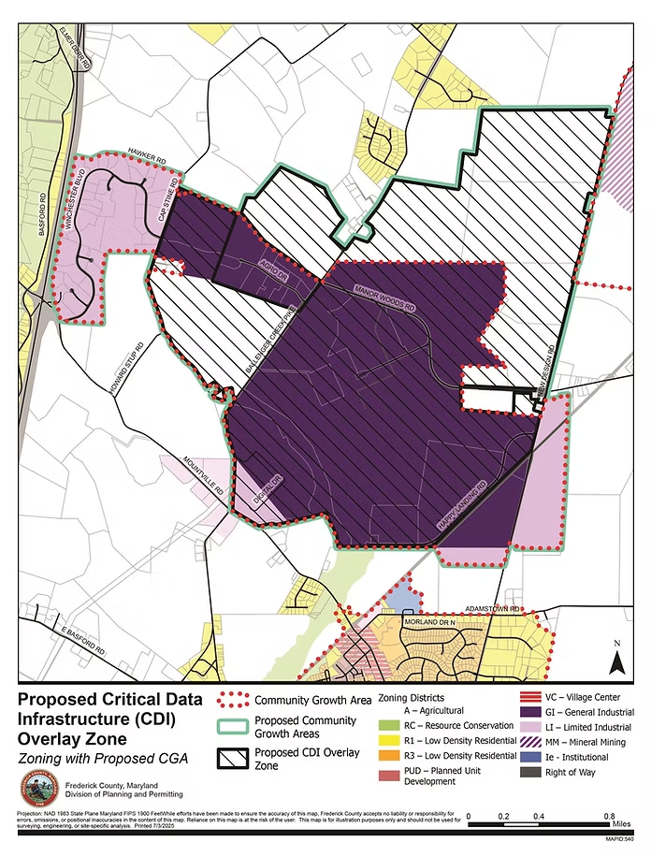
Frederick County
The County passed a “Data Center Overlay Zone” - 1% of the County to be given over to data center development.
A ballot measure referendum to overturn the law was successful - now being challenged by the County and industry.
Notes:
Caroline

Slide 10
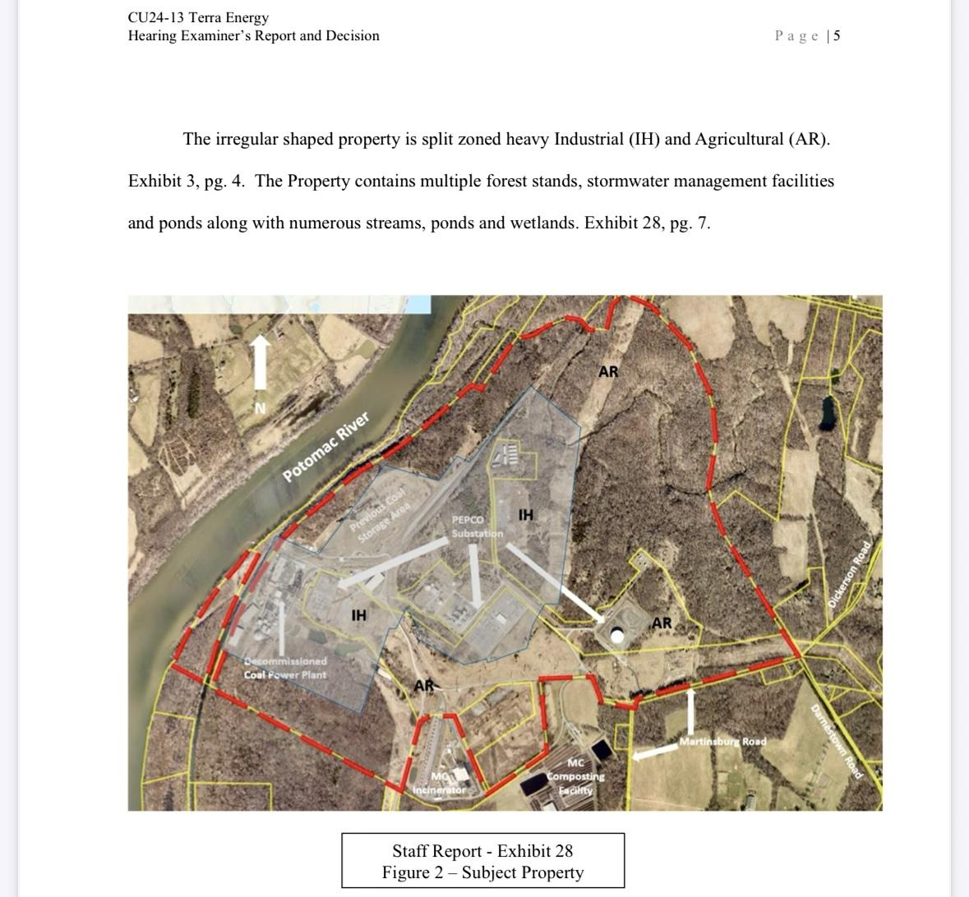
Dickerson Data Center Property
Notes:
Caroline
Lets dive in a bit more to this property - The parts in grey are heavy industrial

Slide 11
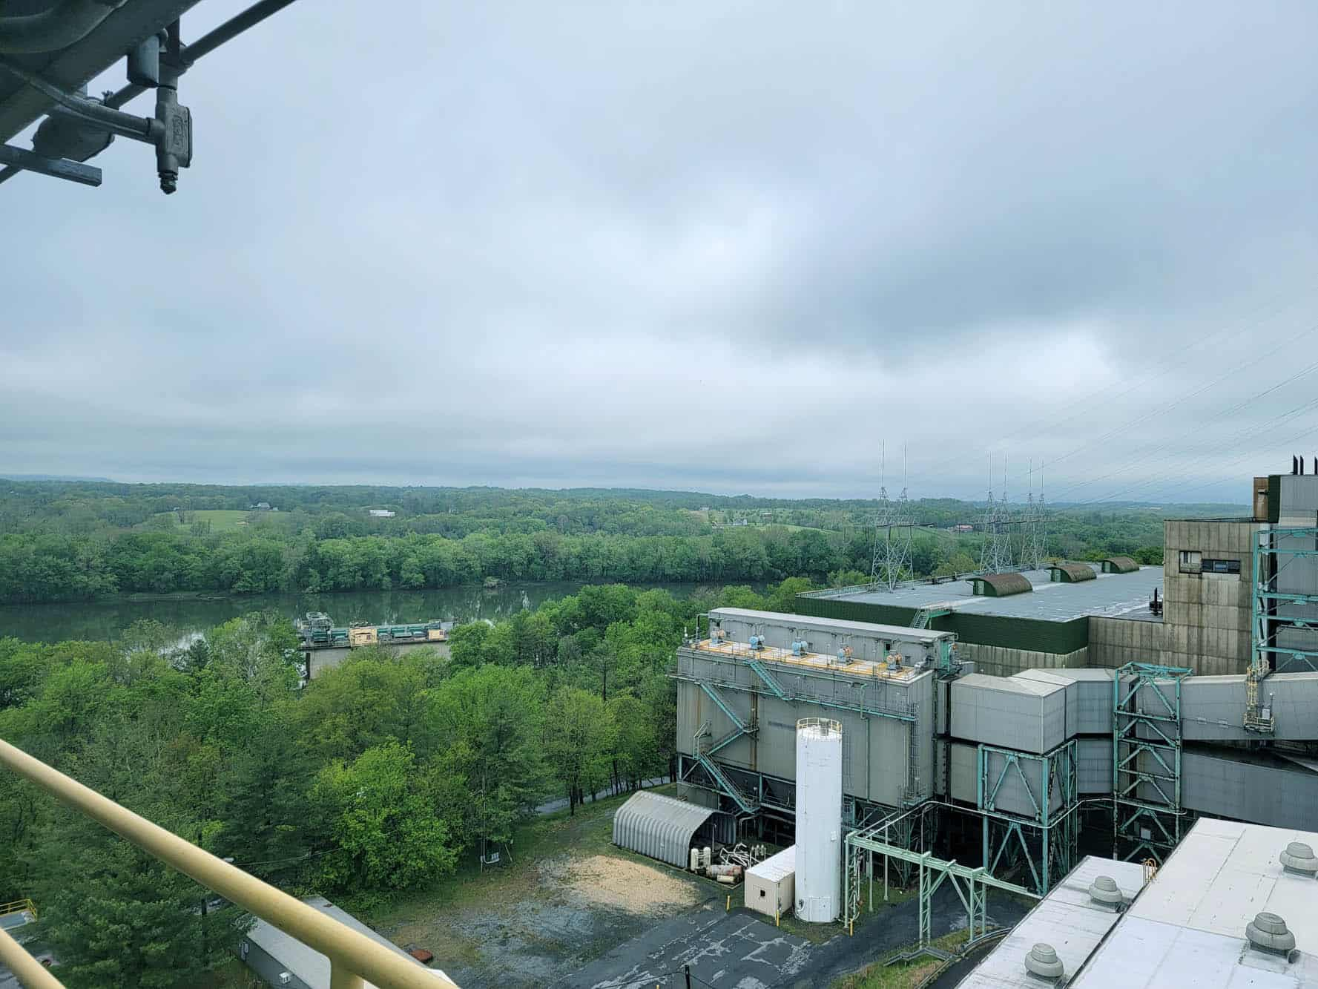
History of the site
Three energy generation functions were historically here - coal, gas and trash incineration
It was a coal fired power plant under various ownership from the 60s through 2020 when the coal plant was shuttered.
Terra Energy purchased 743 acres in 2022
Notes:
Caroline

Slide 12
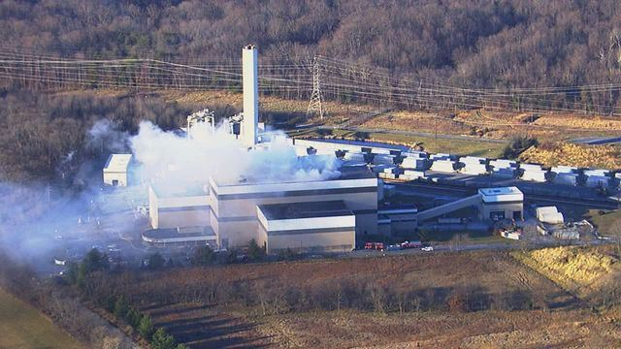
Uses in Proximity
Still existing there:
- The incinerator - calls for it's closure for over a decade - recent dioxin releases.
The council and exec have pledged closure but somewhere else will need to be found for the county's trash
- The composting facility - collects all County yard waste and creates Leafgro.
-Pepco also operates a gas facility there.
Notes:
Caroline

Slide 13
743 acre property
- 255 is Heavy industrial
-488 is AR land
The development is to be contained on the heavy industrial land
Notes:
Caroline

Slide 14
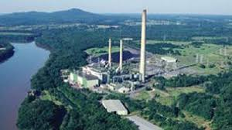
The AR Portion of the Property
Local counsel is working to advance forest and wetlands easements and restoration as well as Maryland Environmental Trust easement on the part of the property that is zoning Agricultural Reserve.
Notes:
Caroline

Slide 15
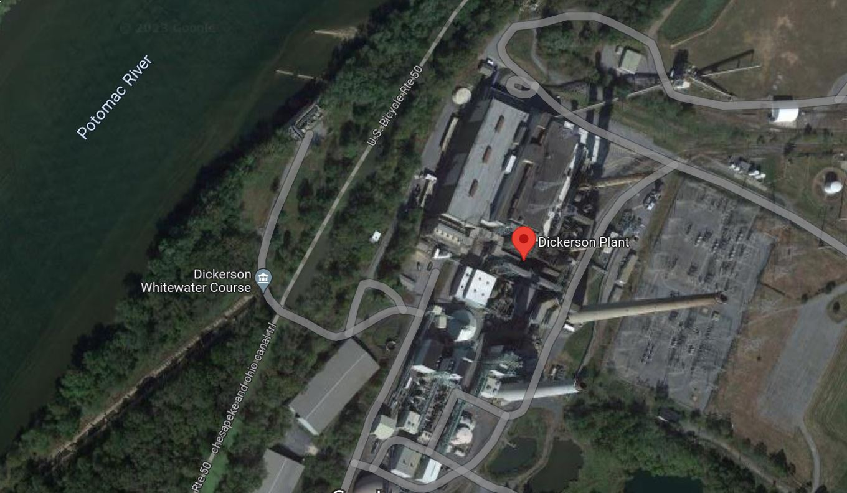
Terra Energy’s Plans
In 2024 Terra Energy proposed data centers for the former Pepco power plant site and some land in the Ag Reserve.
MCA and SCA worked with the applicant to urge balance and collaboration with stakeholders
The Terra site will use water from the Potomac
Notes:
Caroline
Point out C+O Canal

Slide 16
Terra Energy in Dickerson
Five data centers to start - 1,000,000 ft.² of building space
Terra had a preliminary approval hearing in Fall 2024 - their plan has been approved with no information about power or water use.
As part of the preliminary hearing, Terra’s attorney asked that MCA’s testimony raising concerns about water and power use be stricken from the record.
Notes:
Caroline
Want to mention about the attorney striking our testimony from the record

Slide 17
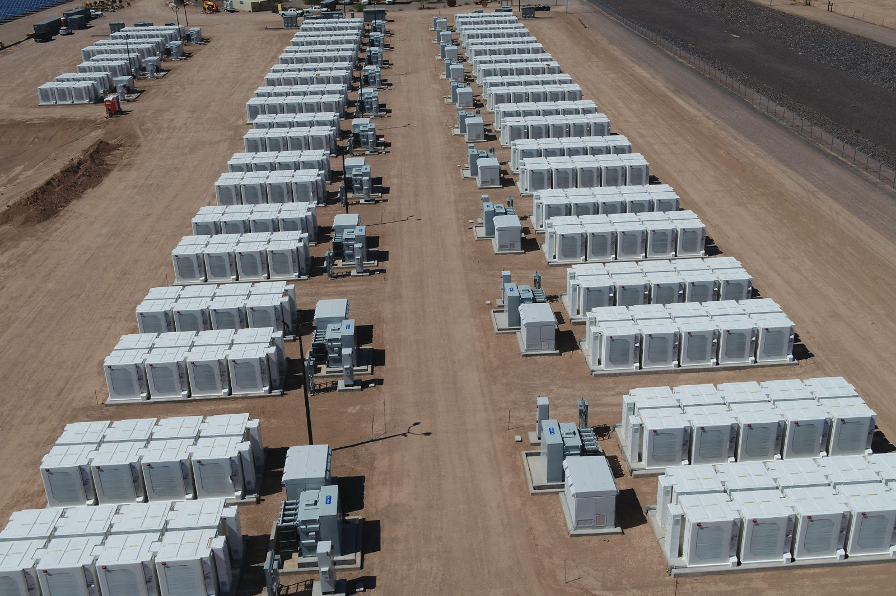
Large Battery Field
Terra’s plans include a utility-scale battery energy facility. The facility would take energy from the regional electricity grid and store it in batteries stored in dozens of shipping container sized structures. That energy would then be provided to utility companies as needed.
Approximately 12 acres of side by side shipping containers
Among the largest of its kind in the country
**not being used for data center backup**
Due to the provisions of the recently passed Renewable Energy Certainty Act (SB 931) this project will not require a conditional use approval and not be subject to public process.
Notes:
Caroline

Slide 18
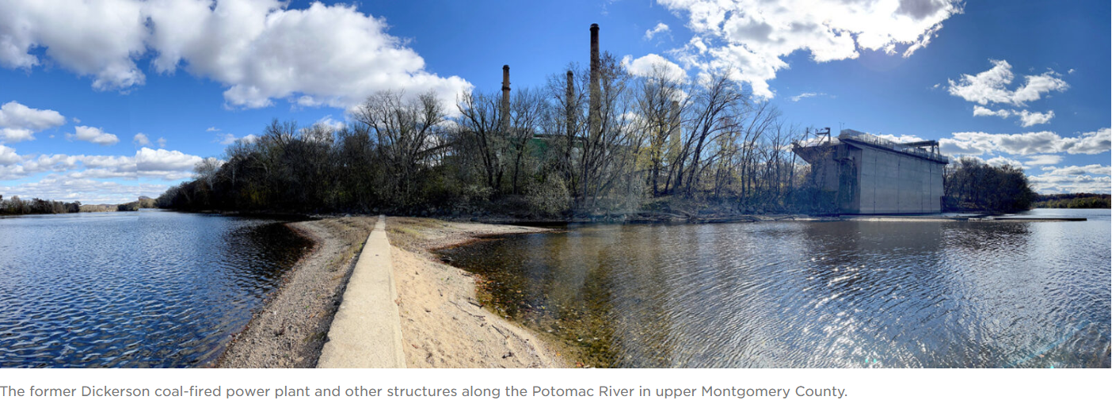
What effect will the data center complex have on the federal parkland: The C&O Canal which is visited by up to 5 million people annually
Notes:
Caroline
Photo from wamu

Slide 19
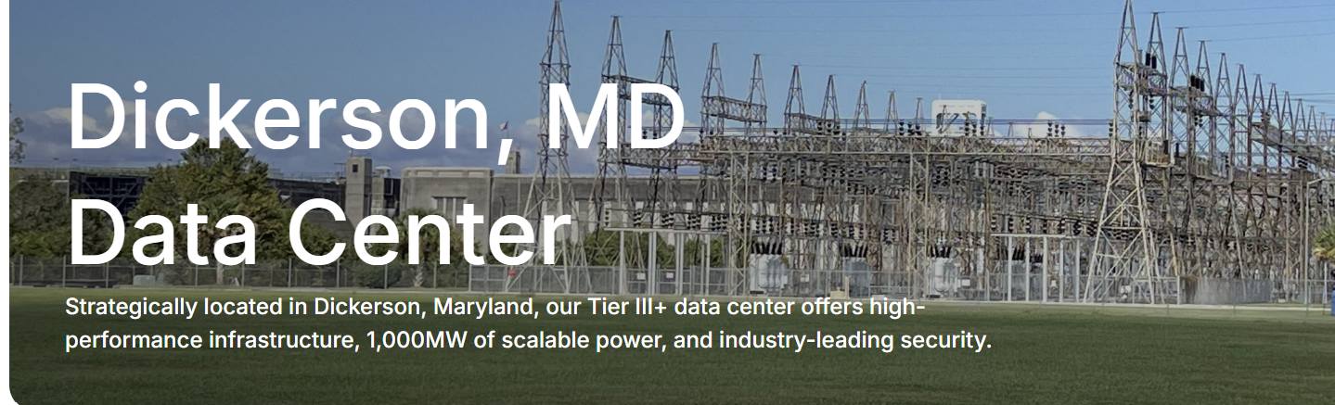
Terra Energy Current Status
Data Center Developer "Atmosphere" has submitted their application for major modification of their conditional use approval to MC planning - but it is not yet public. The project will host up to 30 clients. Atmosphere writes that it "aspires to become the world's greenest data center provider."
This will be a public process- all documents, including site plans, will be available and a public hearing date will be set.
From the Atmosphere site
If approved - project start in 2 years.
Notes:
Already being advertised on their website

Slide 20
Concerns with the Atmosphere Proposal
Water
Fire Risk
Lack of a formal regulatory framework
Power
Emissions
Noise/Vibration
A lack of economic research - who pays for water and power?
Notes:
Caroline

Slide 21
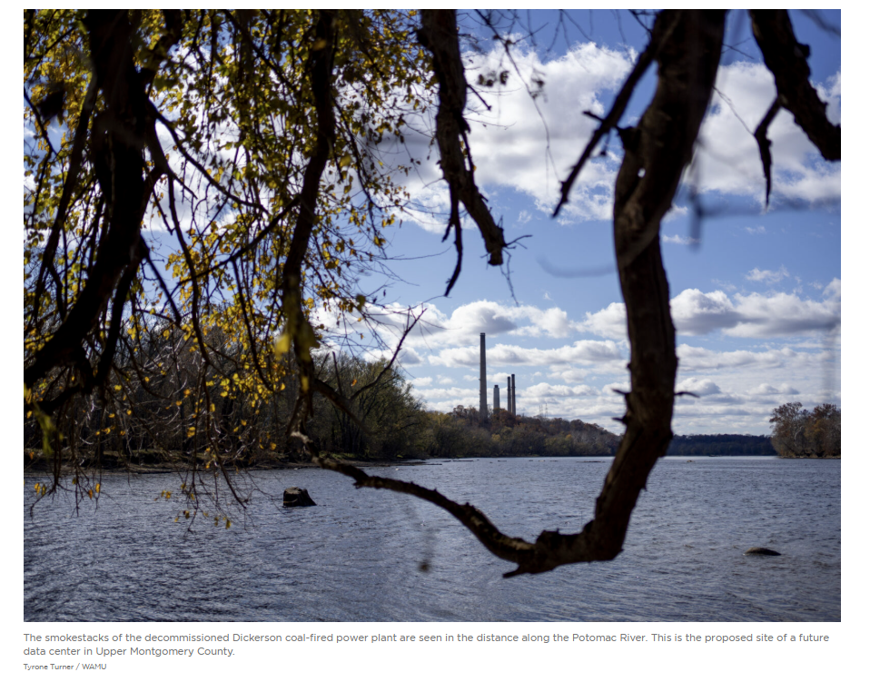
Atmosphere proposes to use Potomac River for all cooling needs
The ICBRB has already established that the Potomac region will face water shortages by 2040.
Additional planned reservoirs have not taken the outsized needs of data centers into consideration. 12% of the River is currently used by data centers in the summer months
Notes:
Caroline

Slide 22
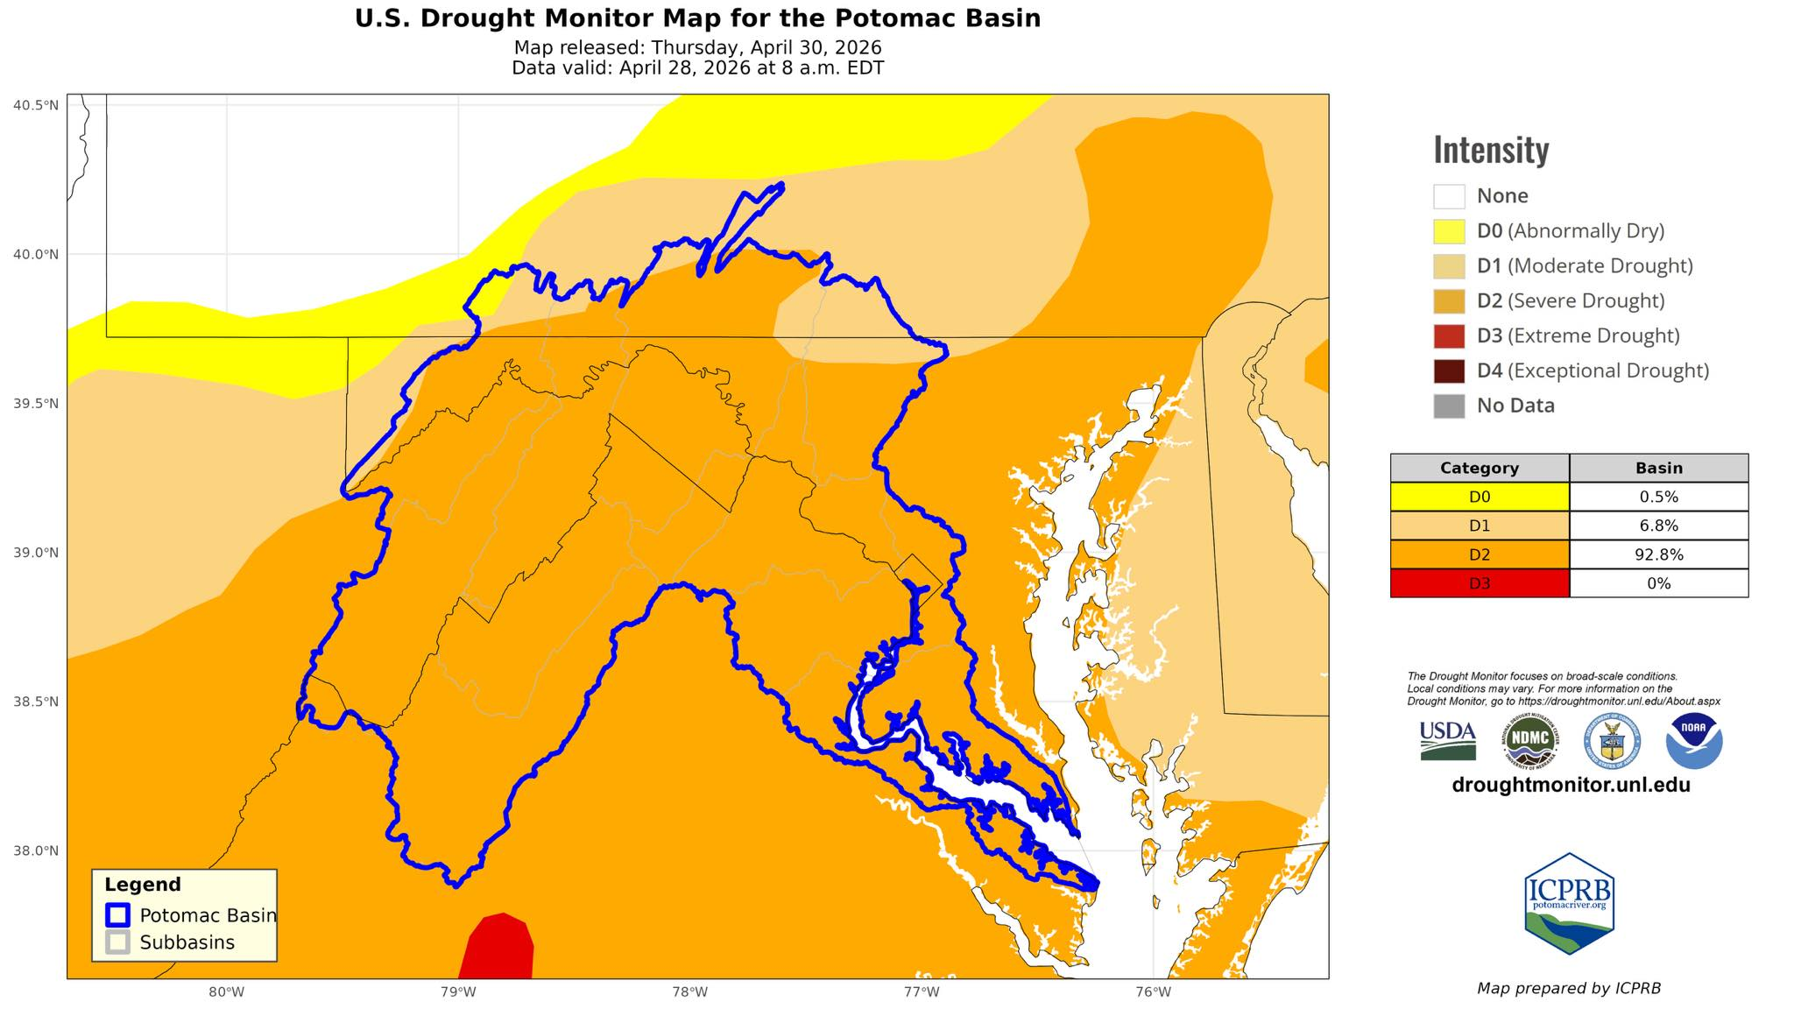
River Report: Flow remains below historical 25th percentile

Slide 23
2 Million Gallons Per Day Permit
Atmosphere has applied for a permit with the state to withdraw up to 2 Million gallons per day from the Potomac.
Atmosphere predicts a loss of 67% to evaporation or other loss.
Water is only used for cooling when air temperatures exceed roughly 75°F Meaning the data center will draw water when the river is at its lowest.
Notes:
Caroline

Slide 24
Closed Loop System Relies on Bleach
Water from the closed system is cycled multiple times and would be discharged at a higher temperature with impacts on aquatic life.
From Atmosphere: The only chemical used is a targeted oxidant (sodium hypochlorite) [bleach] for biological control. Sodium hypochlorite is fully neutralized prior to discharge [into the river].
Notes:
Caroline

Slide 25
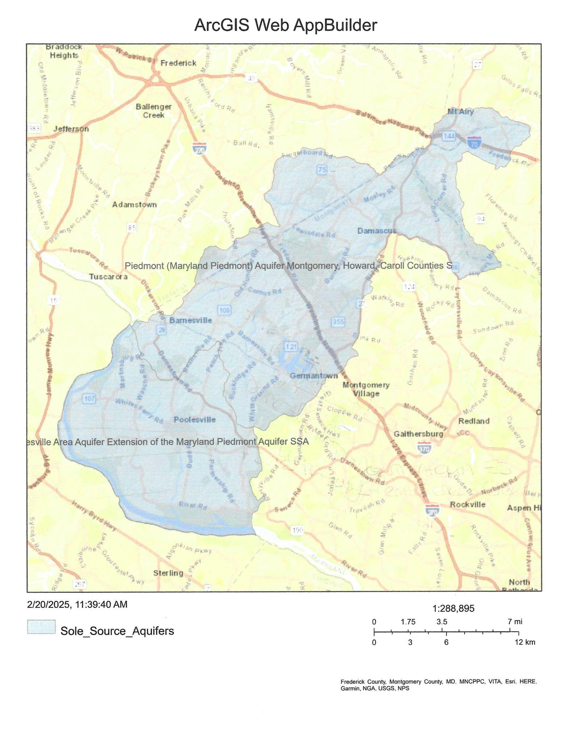
Piedmont Sole Source Aquifer
Supplies at least 50% of the drinking water to the service area - 135 square miles.
No viable alternatives should the water become contaminated/supply dwindle
Fractured crystalline geology is unique - more prone to contamination than other aquifers
Notes:
Caroline

Slide 26
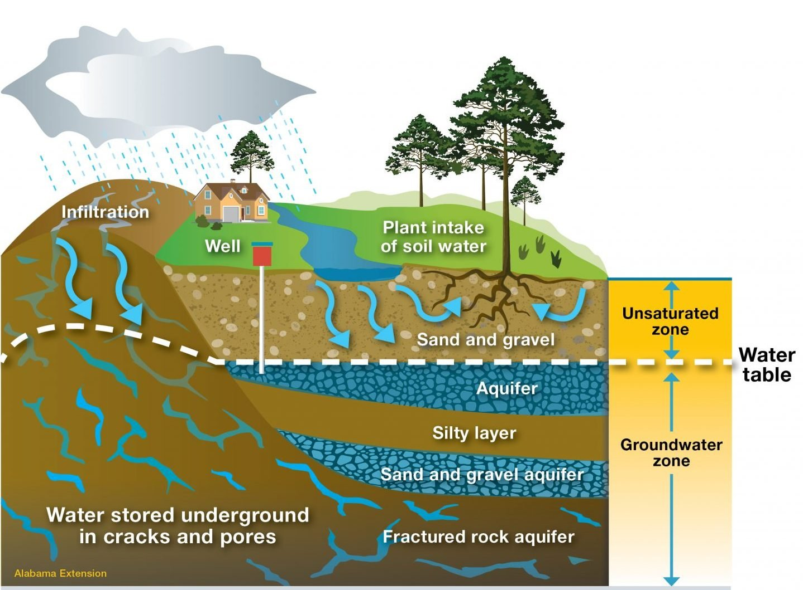
Notes:
Caroline

Slide 27
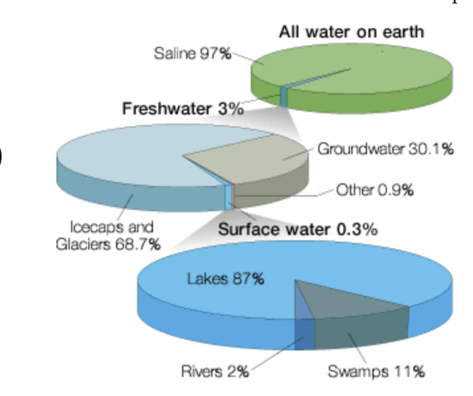
More About Water*
3% of Earth's water is freshwater and 0.5% of that is accessible and safe for human consumption
-N.VA datacenters collectively used 2 billion gallons in 2023
-Loudoun Co. (200 data centers) used 900 million gallons in 2023, impacting both surface and groundwater. This represents a 250% increase in water consumption since 2019
*Environmental and Energy Study Institute 2025

Slide 28
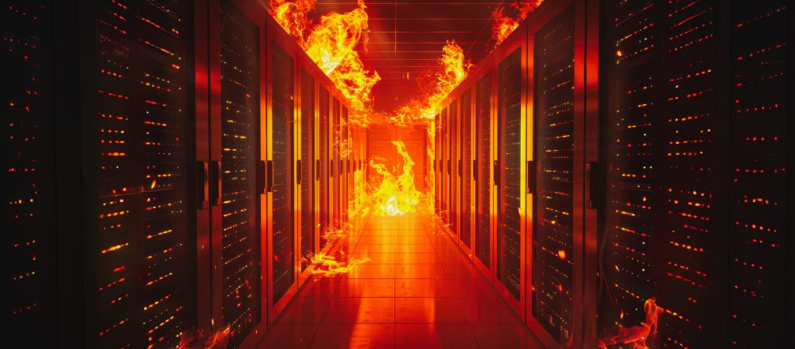
Fire Risk
Both back up batteries and the data centers themselves represent unique challenges for firefighters.
Because of the high voltage needed, the buildings are built without “vault rooms” that shield the rest of the structure from electrical fires. Dickerson is in the only part of the county with only a volunteer fire department.
Notes:
Caroline
This is another aspect that could be helped by having a regulatory framework that works with fire engineers to standardize rules that keep fire pros and the community safe.

Slide 29
Again - Transparency is Lacking
This project was preliminarily approved without:
A regulatory framework governing this type of completely novel land use
A site plan
Data on how much energy/water will be used or how this will impact rate payers
Notes:
Caroline

Slide 30
Power Needs
The project will produce none of its own energy and instead pull from the Potomac Edison grid, only 8% of which is renewable.
Phase 1: 360 MW (149,000 homes/ 243,000 cars)
Phase 2: 275 MW (114,000 homes/ 186,000 cars)
Full buildout would triple the county’s carbon emissions. PJM has forecast rolling brown and black outs due to the growing power needs of data centers as early as summer 2027.
Notes:
Caroline

Slide 31
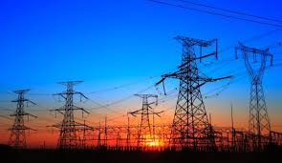
Who pays?
Residential electricity bills will increase 25-70% in the next 5 years to account for Virginia’s already planned growth in data centers.
Where is the economic data on whether promised revenues will balance this burden?
50% of proposed Data Centers across the country have been cancelled or delayed - power companies still must budget for the power - sending rates higher
Notes:
Caroline

Slide 32
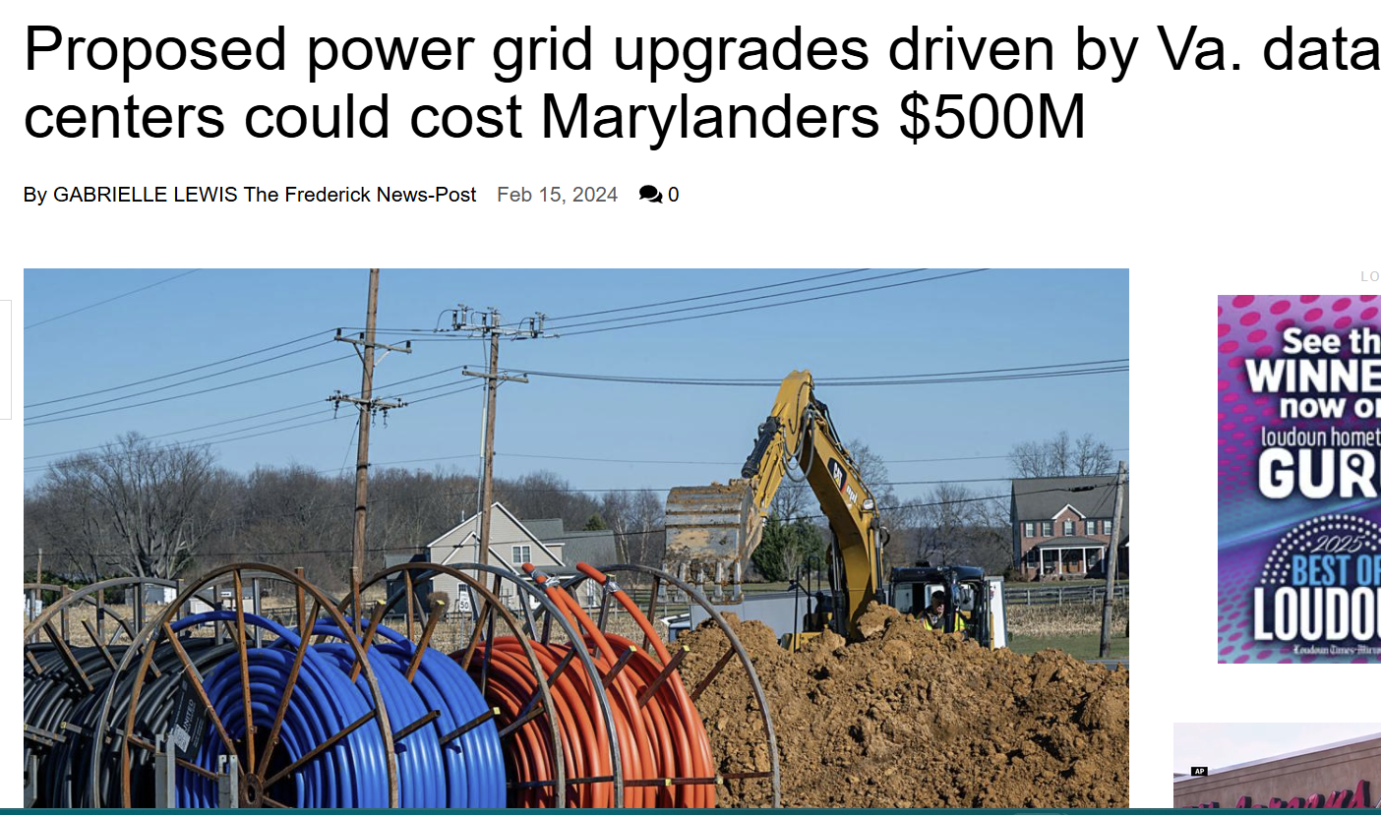
Notes:
Caroline
We are already on the hook for Virginia’s push for data centers. With a proper framework - Maryland can stipulate the data centers have to bring their own energy supplies or pay for grid updates.

Slide 33
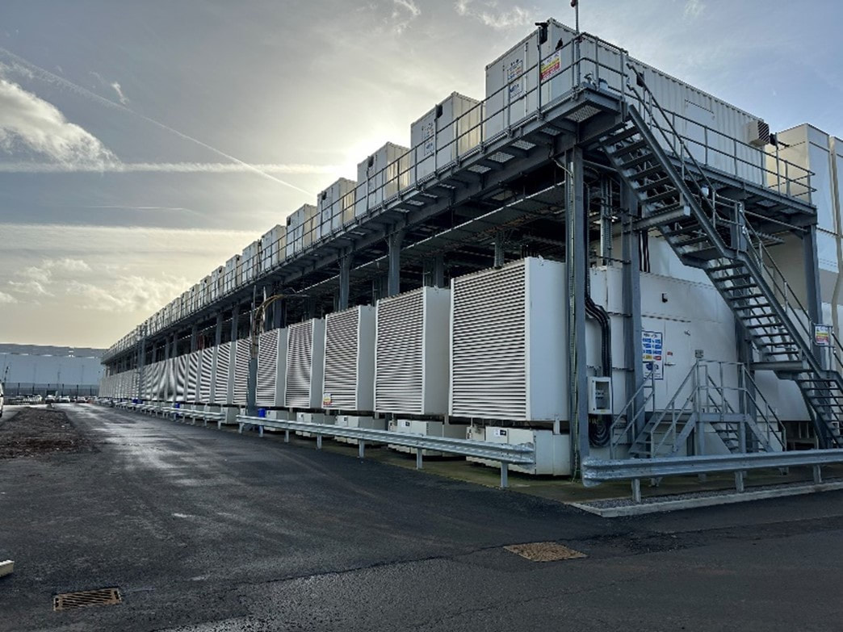
Emissions - Backup Generators
The Project will need around 140 backup diesel generators to cover 120% of power needs in case of an outage. A bill pushed through by the Moore administration in 2024 removed any limit on the number of generators allowed for data center backup. These generators can run 24/7 in an outage and need monthly testing.
Notes:
Caroline

Slide 34
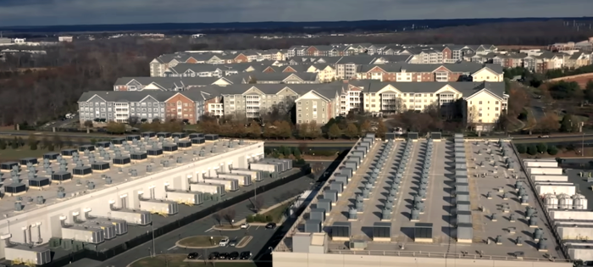
Noise - Vibration
Studies show data centers typically have a 2 mile noise/vibration cone. Atmosphere has said tests show noise from the proposed project is under the limit for local ordinances but that no vibration study is warranted.
The closest home is less than one mile from the proposed site.
Notes:
Caroline

Slide 35
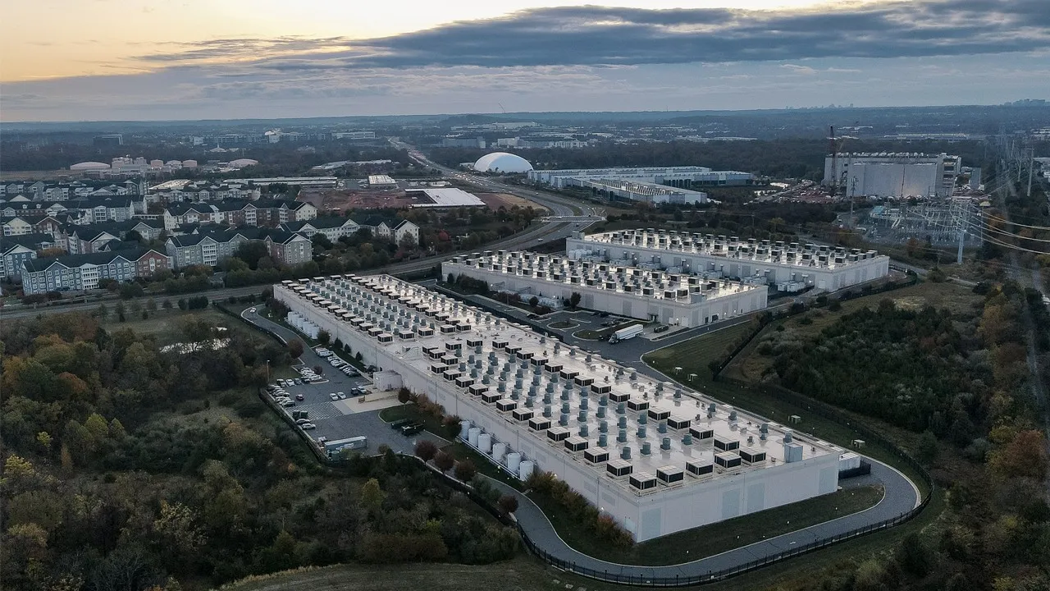
ZTA 26-01 - Allowing Data Centers in Industrial Zones
CMs Fani Gonzalez, Balcombe and Sayles have proposed allowing data centers in all industrial zones of the county (over 2000 acres).
The ZTA as written does not have safeguards for water, power use or emissions- nor meaningful noise protections- but amendments are being crafted to tentatively have a vote in July 2026.
Notes:
Caroline

Slide 36
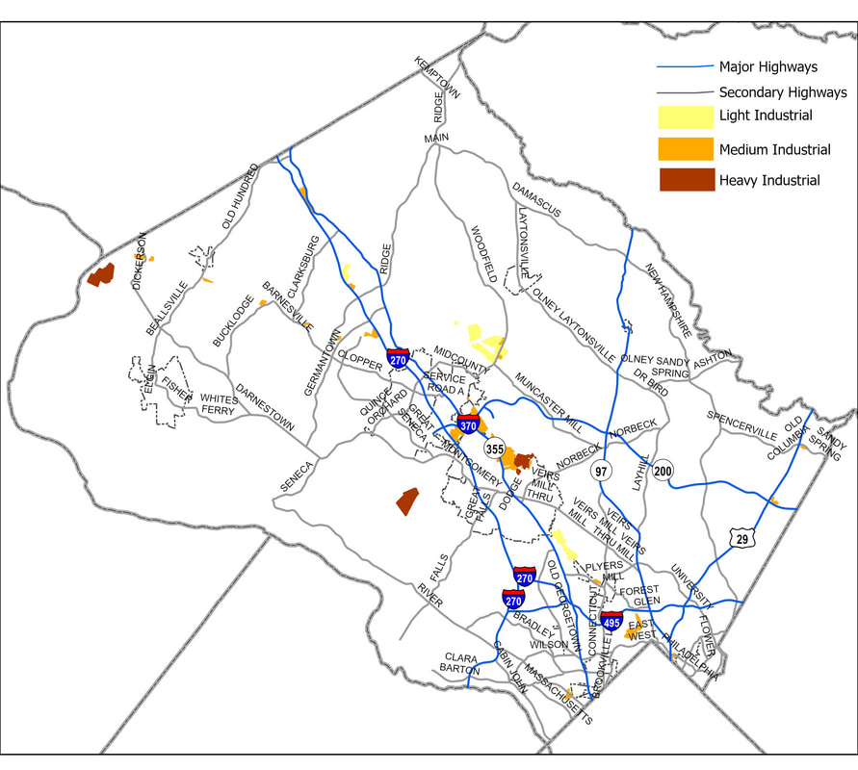
A Data Center in Every Council District?
Notes:
Caroline

Slide 37
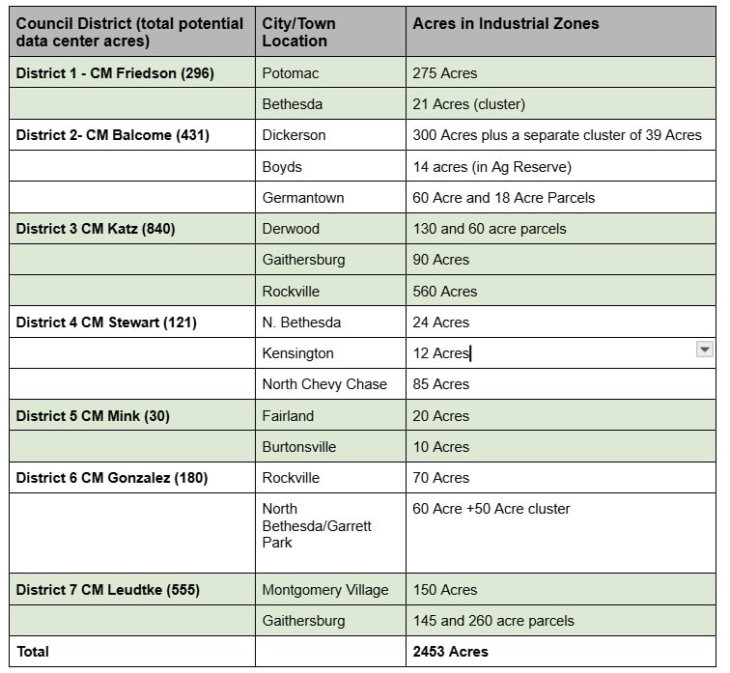
Over 2000 Acres Could Host Data Centers in the County under the ZTA
Notes:
Caroline

Slide 38
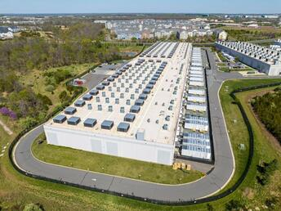
Councilmembers Glass and Jawando Propose 6 Month and 2 Year Moratorium on Data Center Permitting
Evolving Story - Impact Unclear
June 16th Public Hearing for both
Moratoriums are becoming common throughout the nation
Notes:
Caroline

Slide 39
What Can You Do
Write an email to the County Council
Plan to attend the public hearing on June 16th
Notes:
Caroline

Slide 40
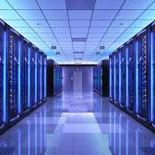

Caroline Taylor
Montgomery Countryside Alliance
Caroline@mocoalliance.org

