Slide 1
COUNTY EXECUTIVE MARC ELRICH
RECOMMENDED FY2023
OPERATING BUDGET
Monday, April 11, 2022
Montgomery County Civic Federation

Slide 2
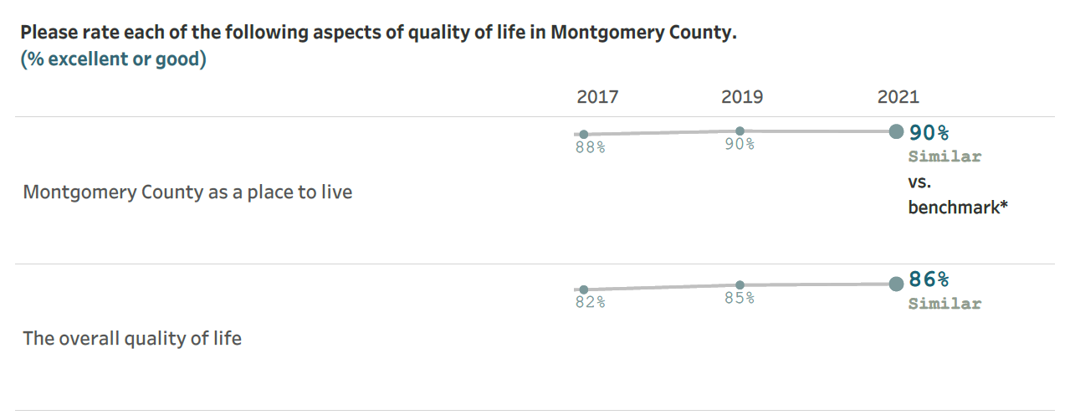

Slide 3
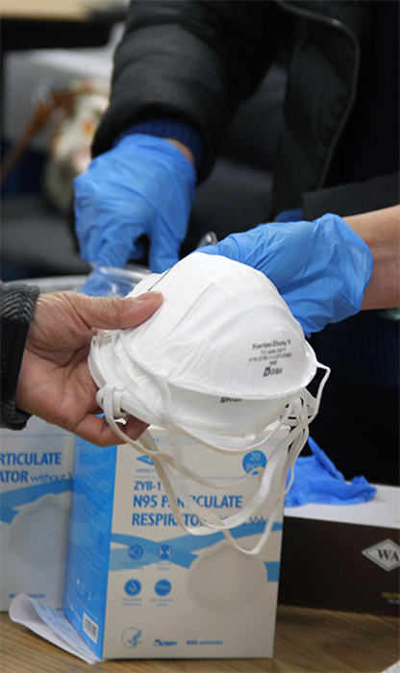
Community challenges
Over two years of COVID-19
Multiple declared states of emergency in Maryland since March 2020
Nearly 2,000 lives lost in the County
Over 165,000 cases of COVID-19 in the County
Increased needs for assistance for individuals, families, and businesses
Unprecedented levels of student learning loss due to pandemic related educational disruptions, especially among lower income and minority students
Skilled labor shortages and supply chain disruptions
High inflation and cost increases as a result of worldwide shortages and labor market pressures
County Executive’s FY23 Recommended Operating Budget

Slide 4
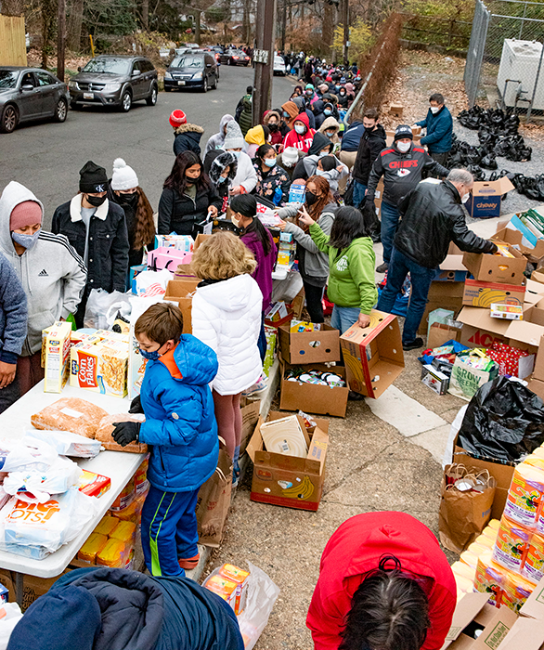
Addressing Needs
Tax revenues out-performing estimates for FY21 and FY22, and FY23 tax revenues revised upward
Fully funds the County’s 10 percent reserve policy
Applies Racial Equity and Climate Change Lenses that are reflected in decisions throughout the budget
Record Funding for Montgomery County Public Schools and significant programmatic enhancements in County Departments that support children
Fully Funds Montgomery College’s request for funding, including $3.3 million for an East County education center
Record funding for climate change initiatives
Record funding for affordable housing projects
Significant enhancements for individuals and families to create food security, financial and housing stability, and more inclusive prosperity
Additional investments in economic development and workforce training
County Executive’s FY23 Recommended Operating Budget

Slide 5
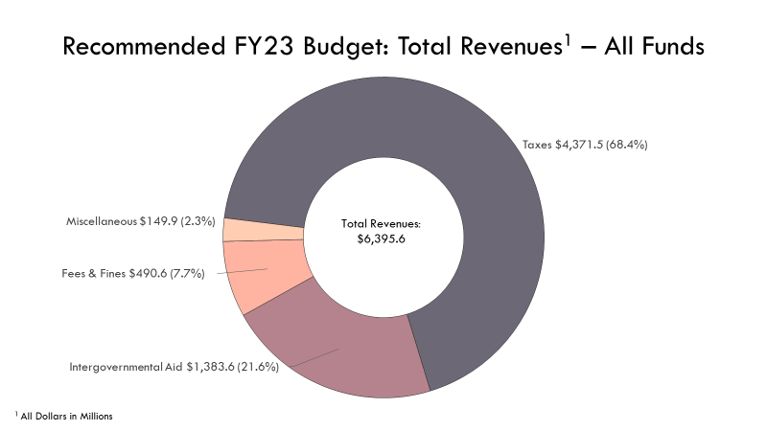

Slide 6
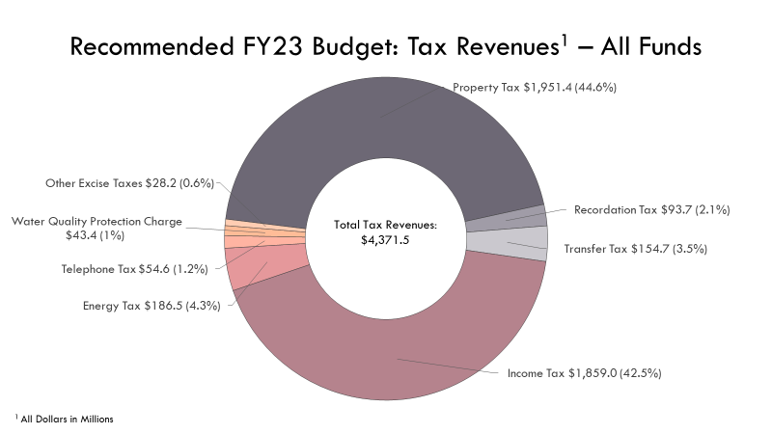

Slide 7
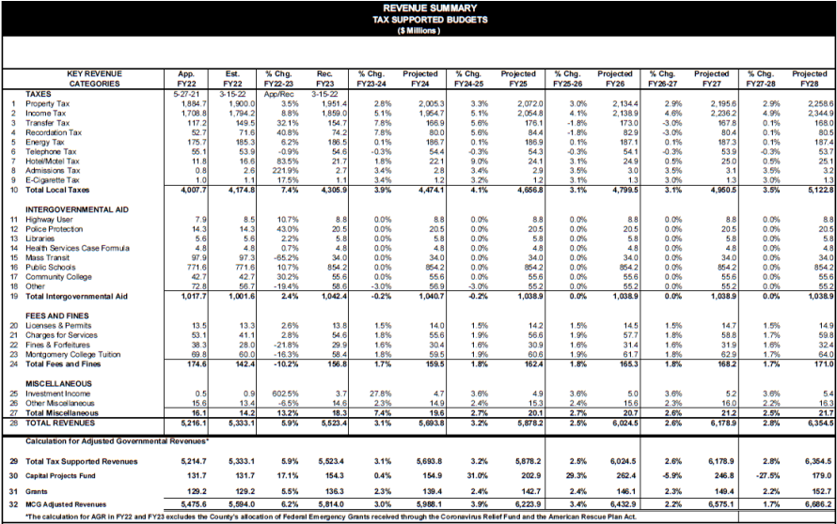

Slide 8
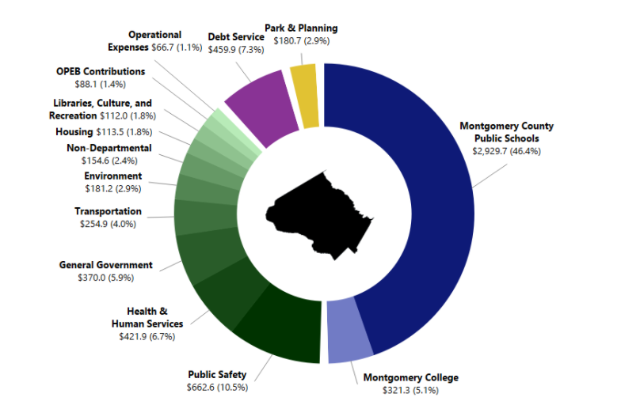

Slide 9
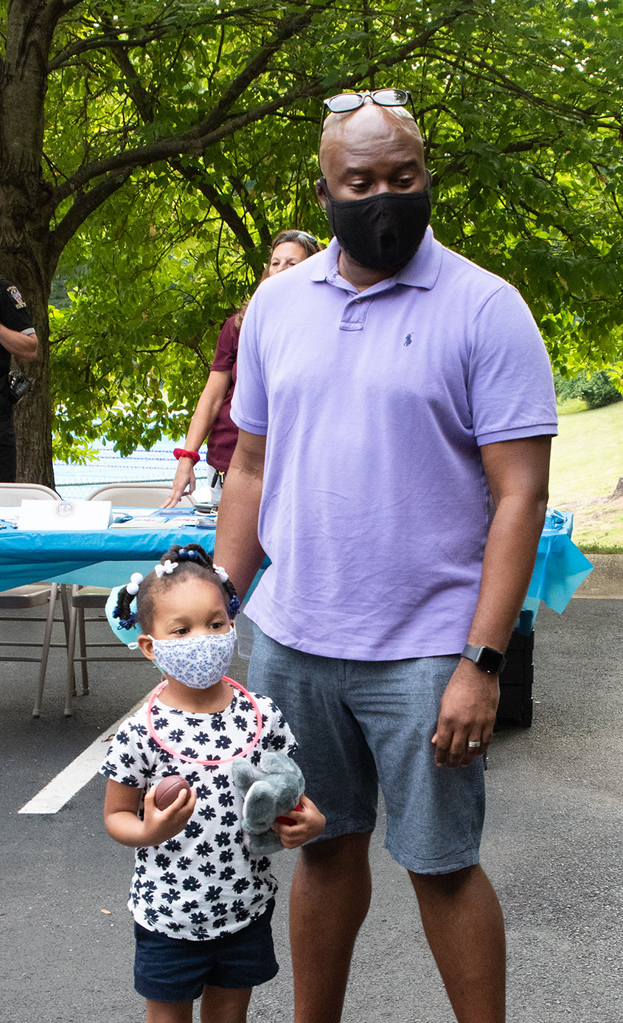
Support for Individuals and Families
$5.6 million in total funding for service consolidation hubs
$5.5 million total programming dollars across County government to support newly arriving migrant and asylum-seeking children, adolescents, and a families
Significant funding increases for the African American Health Program ($2.9 million) Latino Health Initiative ($2.2 million), and Asian American Health Initiative ($1.2 million)
$2.6 million for the second year of the Guaranteed Income Pilot Program
Creation of an Office of Food System Resilience, enhanced grant funding for food assistance programs, and $4 million to continue to directly provide food to individuals and families most at need
Record funding to continue our efforts to end homelessness - $2 million more to provide an additional 120 rapid rehousing slots and $3 million more to increase the maximum rental assistance subsidy for more families in DHHS
County Executive’s FY23 Recommended Operating Budget

Slide 10
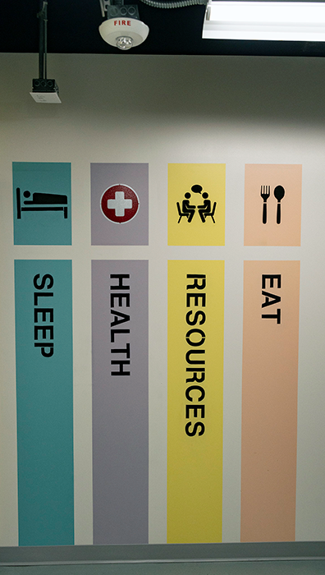
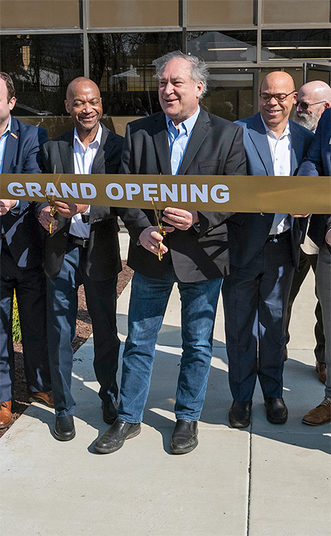
Support for Individuals and Families
$600,000 to provide year-round comprehensive health services to residents of the County’s year-round homeless shelters
$1 million to create and staff a new adult protective services team to investigate cases of abuse of older residents and vulnerable residents
$1.1 million increase to support the Developmental Disabilities Supplement program for a total program budget of $20.3 million
$1.4 million increase for the Medical Adult Day Care Supplement program for a total program budget of $2.1 million
$1 million to support the transition to the 9-8-8 three digit dialing code to connect residents with suicide prevention and mental health crisis services
$800,000 to continue to address increased call volume at EveryMind, the County’s mental health hotline
County Executive’s FY23 Recommended Operating Budget

Slide 11
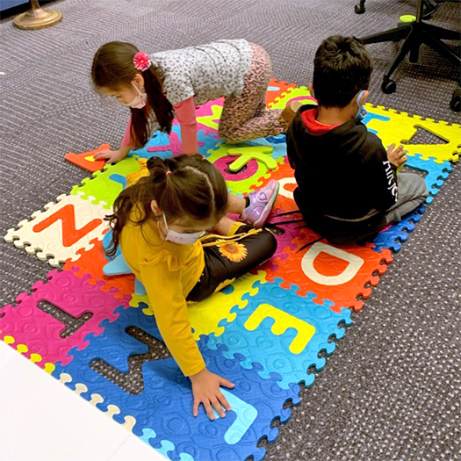
Public Schools & Services for Children
Largest Budget EVER for Montgomery County Public Schools if approved - $2.9 billion - $147.6 million increase from FY22
$117.4 million ABOVE the State’s Maintenance of Effort Requirement
Funds 99% of School Board’s Request, but 100% of Student Needs
$920,000 to open the new Kennedy High School Wellness Center, plus $3.7 million to expand mental health support services at 10 of our highest need high schools without a wellness center
$630,000 to operate new Linkages to Learning Sites at Gaithersburg Elementary School #8 and Odessa Shannon Middle School
Significant enhancements for Out-of-School Time programming - $330,000 for Kids Day Out, $104,000 for Extended Summer Camp Program, $668,000 for two new Excel Beyond the Bell Program Sites, and $350,000 for RecZone Highschool Program
Provides a total of $20 million in resources in FY23 for the Early Care and Education Initiative
$372,000 increase for KID Museum for a total budget of $1.6 million
County Executive’s FY23 Recommended Operating Budget

Slide 12
Environmental Sustainability & Climate Change
Record increases to programs to address climate change
$18.6 million in new funds for the Montgomery County Green Bank
New $1 million program to provide incentives for residential, multifamily, and commercial buildings to replace fossil fuel equipment and appliances with electric ones
Over $1 million to support the implementation of the Building Energy Performance Standards (BEPS) program to reduce energy consumption and greenhouse gas emissions in public and private multifamily and commercial buildings
$675,000 to implement greenhouse gas reduction and adaptation measures in low- and moderate-income housing
$810,000 in additional funding to improve the health of our urban forests
$300,000 for the Community Justice Academy for engagement with vulnerable and historically marginalized communities
County Executive’s FY23 Recommended Operating Budget

Slide 13
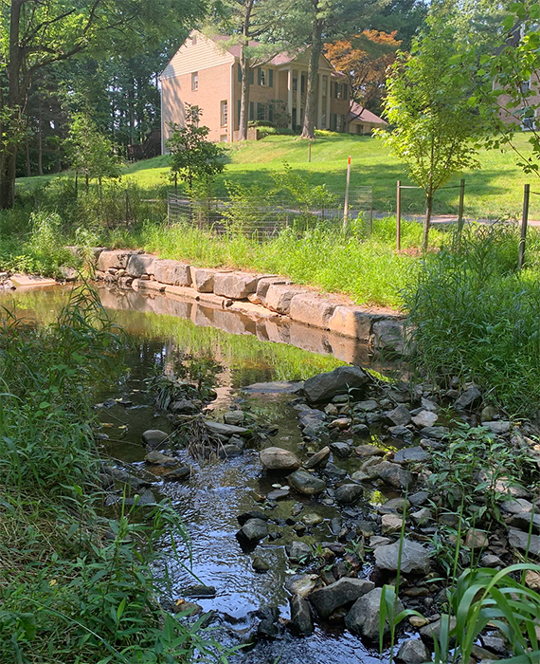
Environmental Sustainability & Climate Change
$100,000 in incentives for individuals and businesses to electrify lawncare equipment
Staffing to develop energy and green building codes and interface with the public about green building compliance, building electrification, and energy efficiency
$1.3 million in enhancements to the Water Quality Protection Fund budget for the Rainscapes program, stream restoration maintenance and inspection, a Senior Engineer position in the Office of Agriculture for soil conservation, among other enhancements
New $400,000 Save-as-you-Throw pilot program in Recycling and Resource Management to encourage residents to recycle more and generate less waste
Broadscale climate communication campaigns, agrivoltaic technical assistance for agricultural land, and an Agricultural Business Development Specialist in the Office of Agriculture
County Executive’s FY23 Recommended Operating Budget

Slide 14
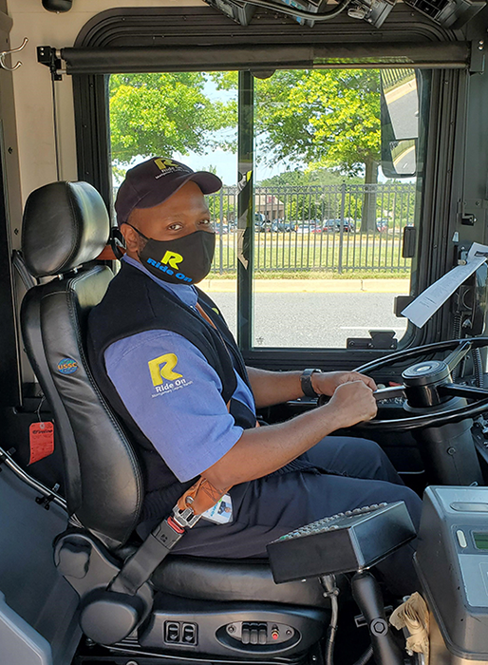
Transportation and Transit
Restores Ride On service and Call-N-Ride to pre-pandemic levels and maintains Bikeshare program
Reduces regular fares on all Ride On routes by one half, bringing the cost of most Ride On trips to $1.00
$1 million to add capital and operating grants programs for Transportation Services Nonprofit Organizations
$550,000 for transportation accessibility initiatives
Aggressively moves forward with a transition to a zero-emissions County fleet by providing $1.8 million to replace fossil fueled County vehicles with zero emission vehicles (this is in addition to the funding included in the capital budget to move to a zero-emissions bus fleet)
Enhanced funding for installation and support for the County’s electric vehicle charging infrastructure
County Executive’s FY23 Recommended Operating Budget

Slide 15
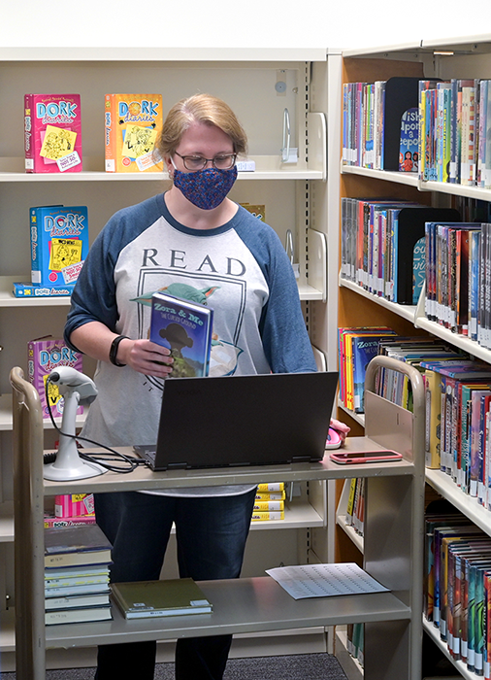
Libraries and Recreation
Montgomery County Public Libraries (MCPL)
$1.5 million in additional funding so that MCPL can fill additional librarian positions to support additional hours and improve customer service
$900,000 in additional funds to purchase eBooks to reduce wait times for residents seeking information
Recreation
$2.3 million to open the South County Regional Recreation and Aquatic Center
Funding to support Independence Day celebrations in Germantown and Wheaton
$250,000 for programs, classes, and events to help older adults overcome the long-term impact of COVID
Additional funding for administrative support and a new community liaison program to enhance outreach and collaboration among community groups
County Executive’s FY23 Recommended Operating Budget

Slide 16
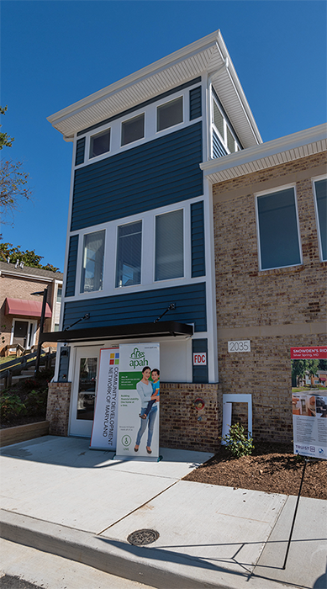
Affordable Housing
Highest level of funding in County history – nearly $140 million to expand the preservation and production of housing that is affordable to the most economically burdened residents
$57 million for the Montgomery Housing Initiative operating budget
$42.7 million for existing capital projects
$40 million for a new Naturally Occurring Affordable Housing (NOAH) Fund capital project
The NOAH Fund project will preserve and create affordable housing properties in areas at risk of rent escalation to higher market rents, including the Purple Line Corridor and County transit corridors
Continues funding support of the Building Neighborhoods to Call Home program and the Housing First program
Sets aside $2 million from existing resources to explore, subject to the County’s collective bargaining laws, a pilot program for down payment assistance to full-time career employees of Montgomery County and Montgomery County Public Schools to help make first time homebuying more affordable in the County
County Executive’s FY23 Recommended Operating Budget

Slide 17
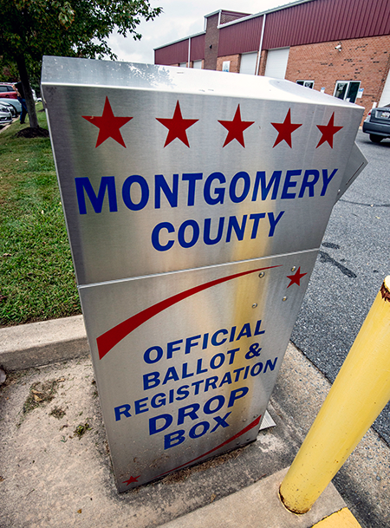
Effective & Sustainable Government
$2.3 million increase for Board of Elections for general election support
$2.5 million to fully fund the recommendation for the Public Elections Fund
Additional support for MC311 (six term positions) and the Public Information Office (two communications officers) to enhance public engagement
Significant enhancements for OHR to bolster recruitment, training, classification and compensation, and replace the applicant tracking system
New capital asset management system in DGS to track, monitor, and provide long range planning for maintenance and replacement of capital assets
Significant enhancements to the County’s cybersecurity and technological infrastructure
County Executive’s FY23 Recommended Operating Budget

Slide 18
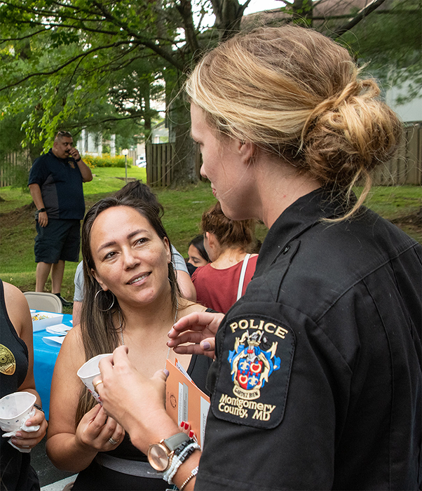
Public Safety
Police Department
Enhances police recruitment and retention by strengthening the competitiveness of police compensation in relation to neighboring jurisdictions
Expands the police recruitment unit to attract top talent
Adds three civilian staff to support Public Information Act requests
Adds two sworn positions to support random review of police footage
$90,000 to purchase non-lethal pepper-ball guns
In the Office of Human Resources, provides one new position to support mental health assessments for police officers and sheriff's deputies
$800,000 in the Office of Emergency Management and Homeland Security for non-profit security grants for organizations at high risk of experiencing hate crimes
In the Department of Correction and Rehabilitation, eliminates administrative fees for participants in court related diversion programs including the Intervention Program for Substance Abusers and Alternative Community Services Programs and creates the bakery program to expand workforce development programming for inmates
County Executive’s FY23 Recommended Operating Budget

Slide 19
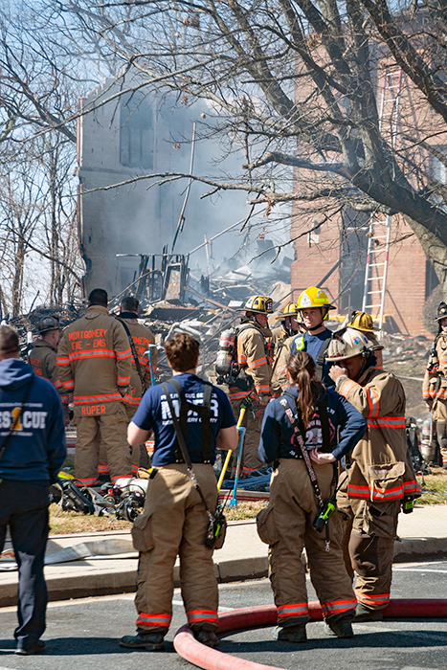
Public Safety
Fire and Rescue Services
Leverages funds from the State's Emergency Service Transporter Supplemental Payment Program to:
Expand the Mobile Integrated Health Program to address the needs of frequent 911 callers
Add a Paramedic Chase Car to Serve Silver Spring
Add career staffing at Sandy Spring Fire Station 40 to bolster volunteer staffing
Add an Emergency Medical Service (EMS) System Capacity Officer to balance emergency department loads
Add an EMS Duty Officer position to enhance medical supervision in the field
$1.65M for Local Volunteer Fire Departments to enhance EMS activities and infrastructure
Funds two new positions to expand mental health services for fire and rescue personnel
County Executive’s FY23 Recommended Operating Budget

Slide 20
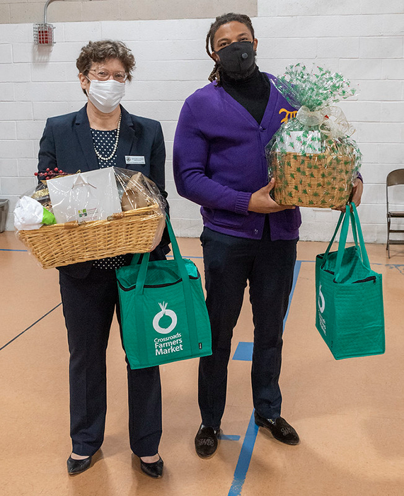
Community Partners
New Office of Grants Management is established
Six percent inflationary adjustment for nonprofit service provider contracts across County government
46 programs previously funded through Community Grants Non-Departmental Account budget moved to the base budgets of departments ($2.3 million)
$8.2 million for community grants in the Community Grants Non-Departmental Account
$3 million for capital cost sharing community grants
Three broad buckets of funding for grants in FY23
$750,000 - Nonprofit technical assistance and management support
$750,000 - Children, youth, and family programs in underserved communities
$500,000 for business district development grants
County Executive’s FY23 Recommended Operating Budget

Slide 21
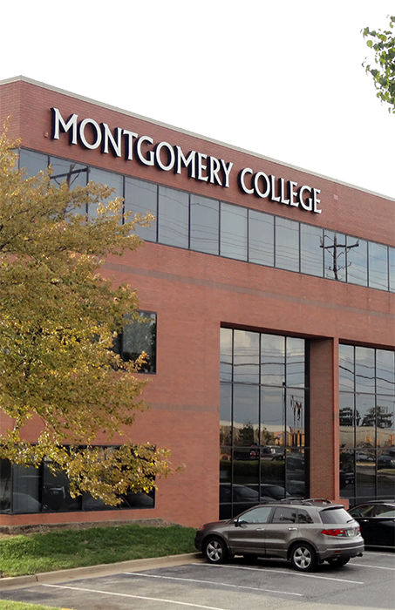
Economic Development, Workforce Training, & Montgomery College
Fully funds Montgomery College’s budget request, including $3.3 million to establish the College’s East County Education Center
$1.2 million increase for Montgomery County Economic Development Corporation
$500,000 increase for the Conference and Visitors Bureau to attract visitors to the County and additional funds to compensate the organization for lagging hotel tax revenue
$350,000 in new funding for WorkSource Montgomery to assist refugee and immigrant adults with professional development, skills training, and support services
$317,000 in new funding for WorkSource Montgomery to provide skills to those exiting the correctional system
$60,000 in new funding to WorkSource Montgomery for additional slots in the Summer RISE 2023 program
County Executive’s FY23 Recommended Operating Budget

Slide 22
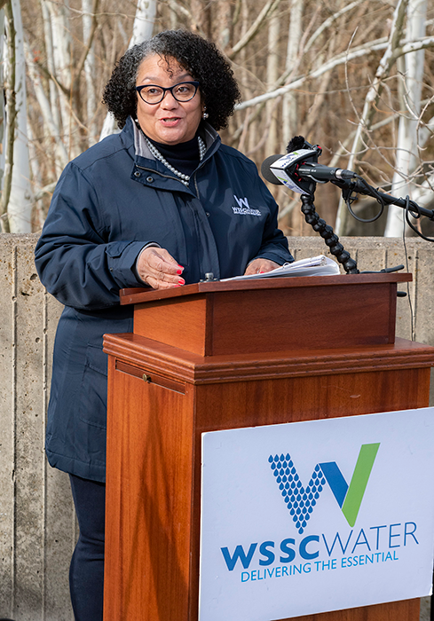
Other Enhancements
Maryland-National Capital Park and Planning Commission – total budget increase of $10.6 million ($180.7 million)
WSSC Water – 6.5% rate increase per the Council’s Spending Affordability Guidelines
Payments to Municipalities Budget increases by $8.1 million (including the consolidation of the Takoma Park Police Payment into this budget), to implement the newly negotiated agreement with municipalities on reimbursements of duplicative services
Fully Funds the request of the County Council and Legislative Branch departments
Adds funding to restore the Office of the People’s Counsel in the Legislative Branch
County Executive’s FY23 Recommended Operating Budget

